Slide 1
E-Business Infrastructure
SE-413
Week 2

Slide 2
E-Business Infrastructure
Refers to the combination of hardware such as servers and client PCs in an organization, the network used to link this hardware and the software applications used to deliver services.
Applications, Operating Systems, Servers and Networking equipment.

Slide 3
Intranet Vs Extranet
Internal vs Externally Exposed Network
Advantages:
Reduced cost
Safe Distribution of Information
Better Customer Service

Slide 4
Middleware
Used to enable two applications that do not support common protocols to connect to each other.
Transformation of different data types
JSON vs XML
Used in the integration of two or more smaller applications to form a larger application.

Slide 5
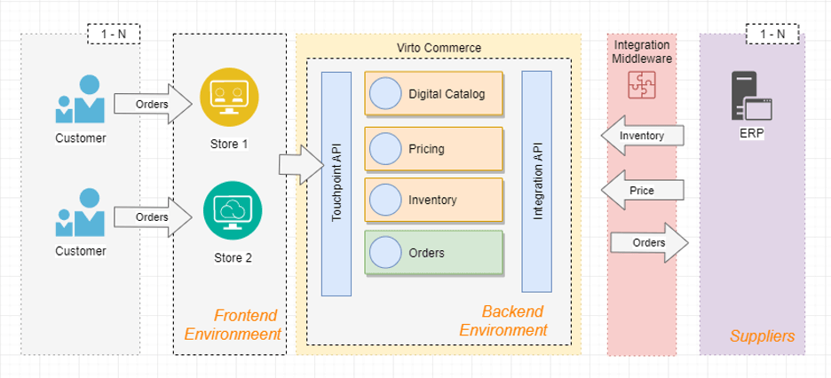
Middleware

Slide 6
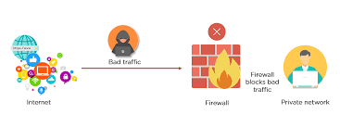
Firewalls
Used to protect networks from malicious attacks
Usually deployed at the edge of a network
Can be software or hardware
IP Whitelisting
Categorizing an IP to be trustable to access a resource.

Slide 7
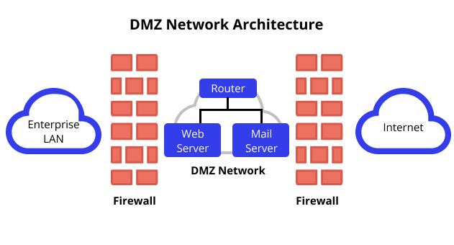
De-Militarized Zone (DMZ)
Network between Intranet and the Internet
Hosts servers containing information available to public or Extranet users.
Sensitive information is kept on Intranet which is separated by a Firewall.

Slide 8
Network Interconnection
OSI Layer
Application
Presentation
Session
Transport
Network
Data Link
Physical
TCP/IP is the main protocol used for transportation of data
HTTP - Main application level protocol

Slide 9
Domain Names
Used to name resources on the internet
DNS - Domain Name Server
Reverse-DNS - Resolves IP to Name
TLD and Subdomain

Slide 10
HTML
Hypertext Markup Language
What is Hypertext?
Text that has a link/reference to other pages or parts of text.
Structured Language used to create Web pages
Allows for definition of properties of elements (meta information).
<bold></bold><italics></italics>
Largely presentational

Slide 11
XML
eXtensible Markup Language
Allows us the ability to provide information about data (meta-data)
Can be used to define resources
Server information (url, port)
Application configuration (database credentials, enable or disable components)
Database row( <table><row><id>1</id><name>ABC</name></row></table>
Documents
contains doctype and xml-stylesheet definition to define document structure

Slide 12
JSON
JavaScript Object Notation
A Very popular alternative to XML for defining resources
Supported by a large number of hardware and software
Example:
{ "employees":[ {"firstName":"John", "lastName":"Doe"}, {"firstName":"Anna", "lastName":"Smith"}, {"firstName":"Peter", "lastName":"Jones"} ] }

